Slide 1
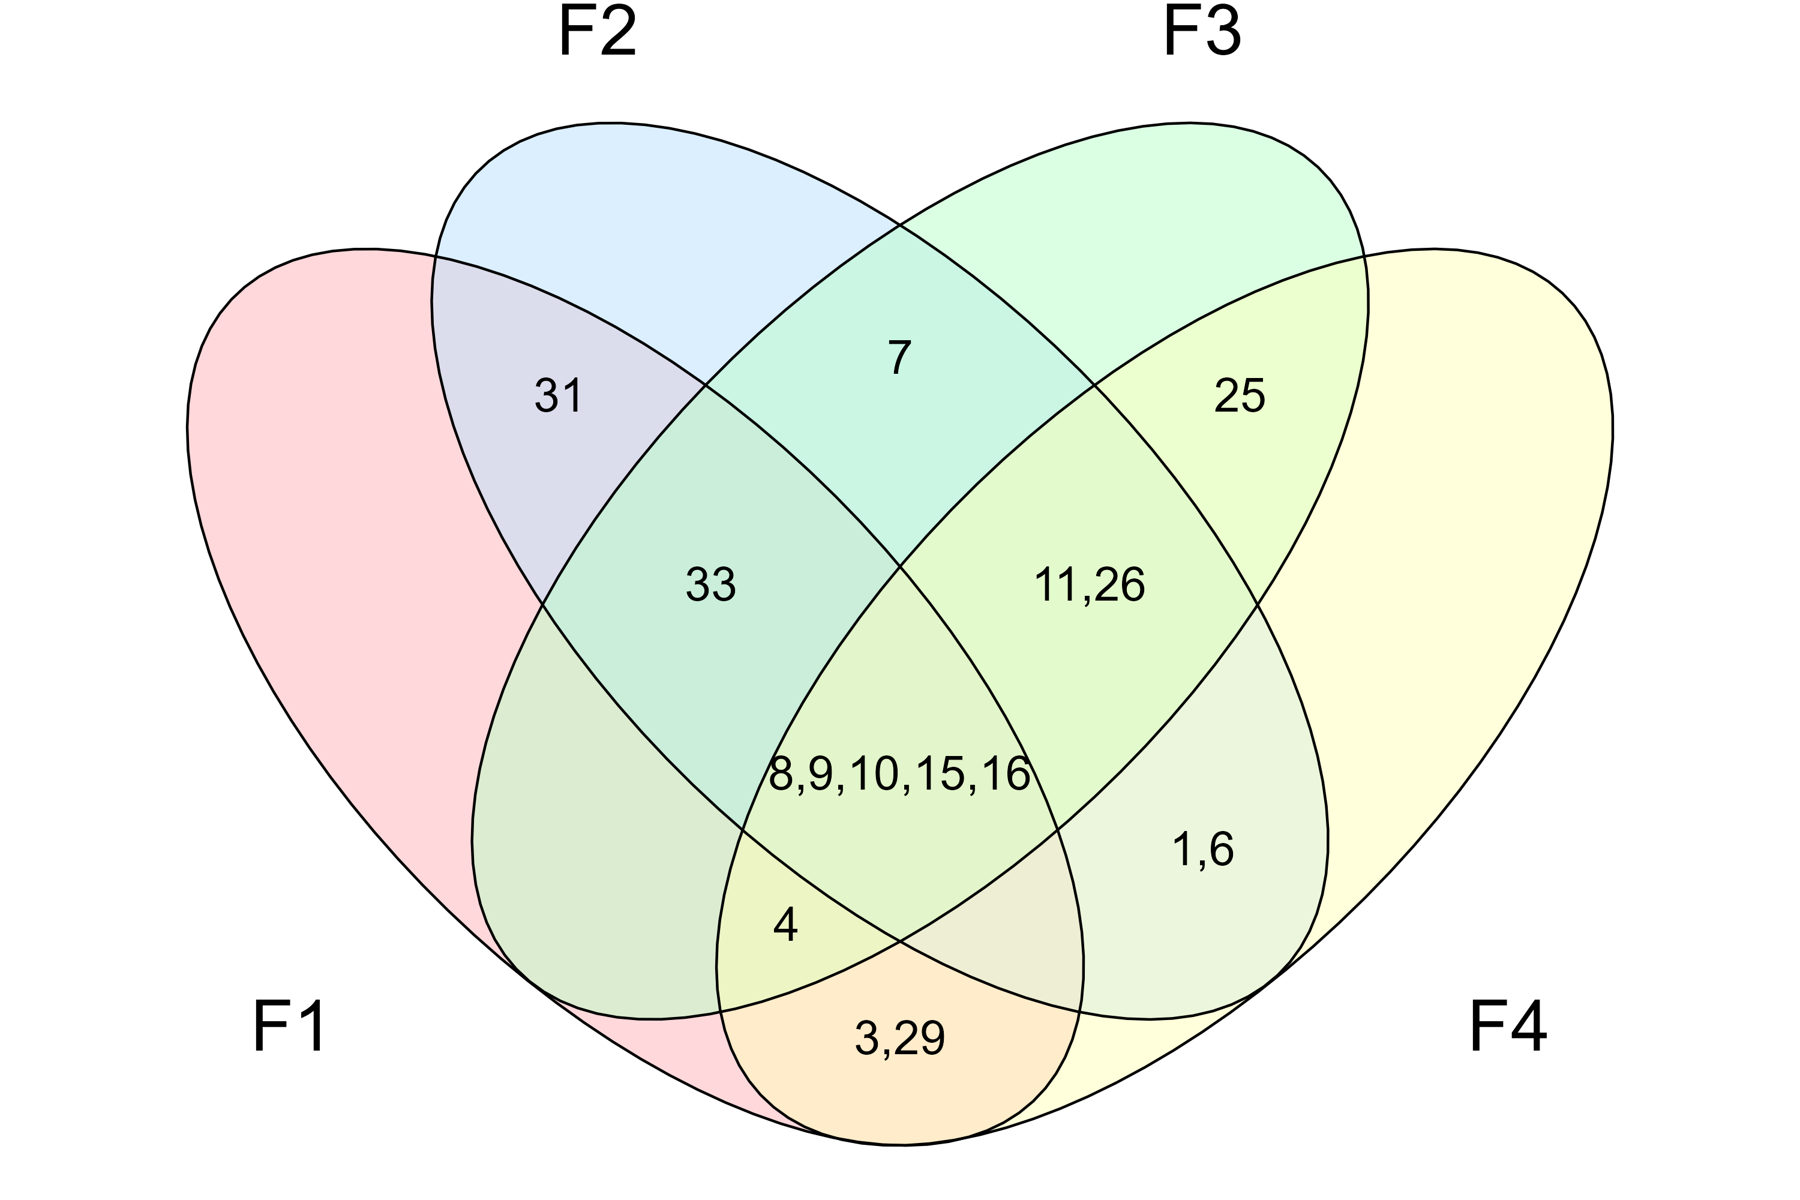
F2 – Networked shocks
F3 – Global governance
A phenomenon underlying the polycrisis is an accumulation of wears and tears.
The current state of knowledge does not allow us to understand the state of the polycrisis.
Responses must be coordinated.
Understanding the polycrisis is beyond what is individually possible.
We are not in ‘the' polycrisis as much as a polycrisis.
-
The polycrisis is the product of human interconnectivity.
The polycrisis concept captures the complexity of the world.
The list of crises that make up the current polycrisis is clear.
-
Even ill defined, the concept is useful
F1 – Analytical tractability
F4 – Conceptual stringency

